Slide 1
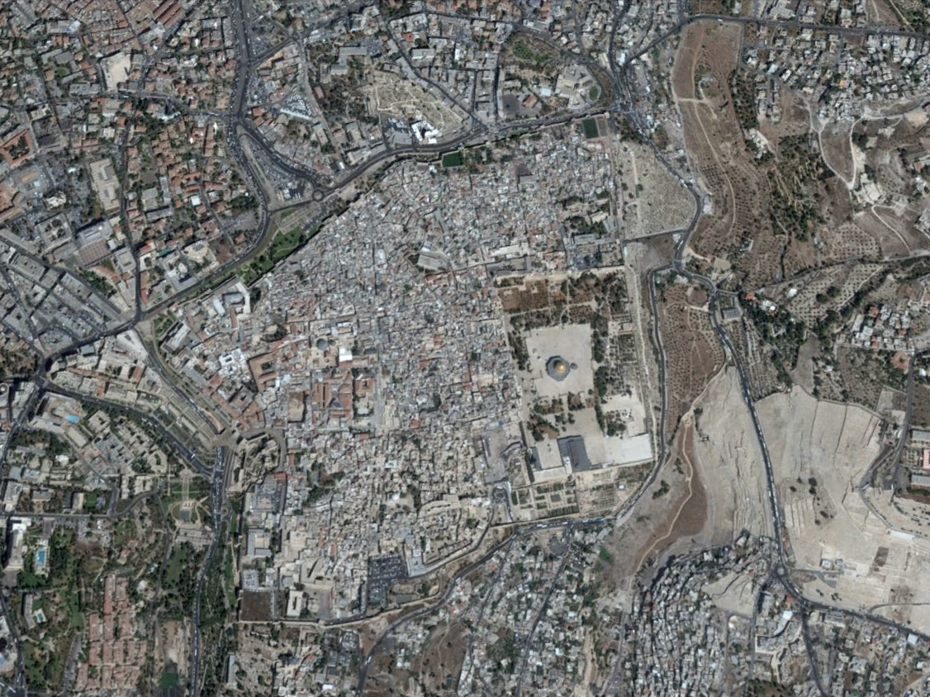
From: Google Earth
The National Hotel
Herod’s Gate
Damascus Gate
Lions Gate
Garden of Gethsemane
New Gate
Temple Mount / Dome of the Rock
Eastern Gate
Jerusalem Old City
Mt of Olives
Jaffa Gate
Dung Gate
City of David
Zion Gate
1

Slide 2
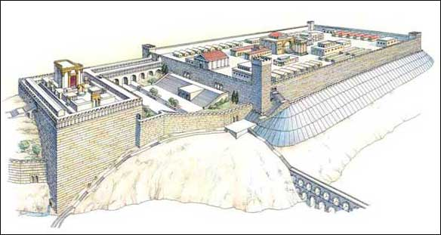

Slide 3
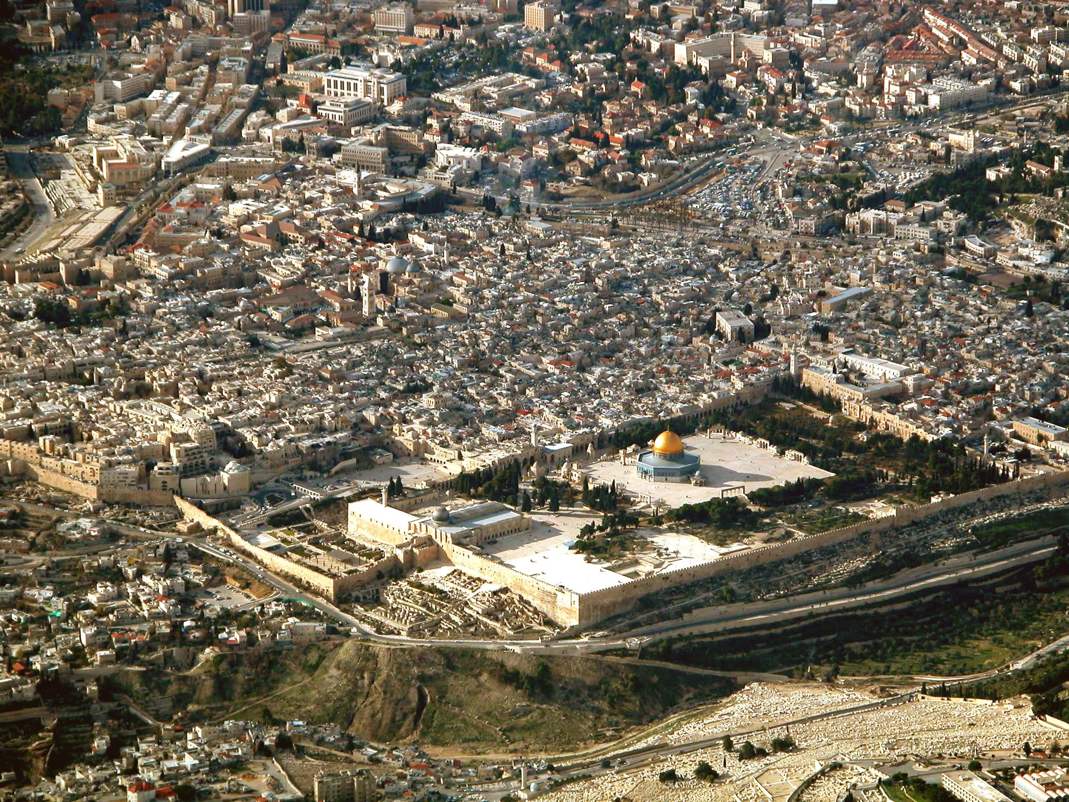

Slide 4
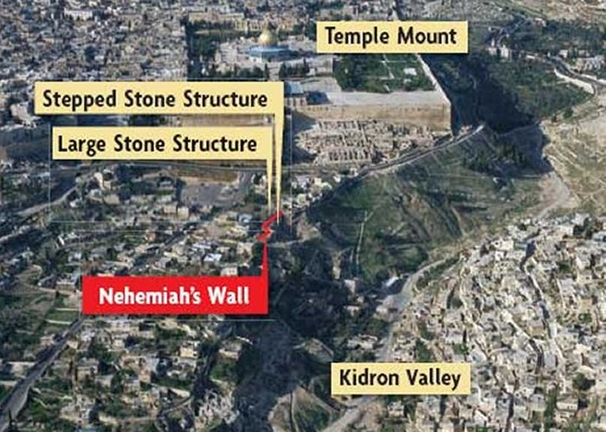

Slide 5
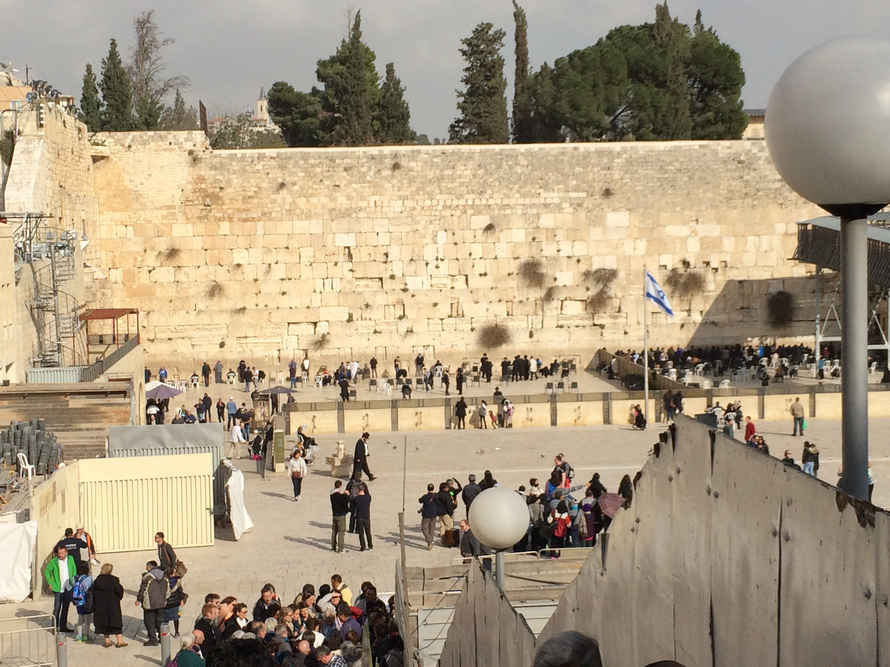

Slide 6
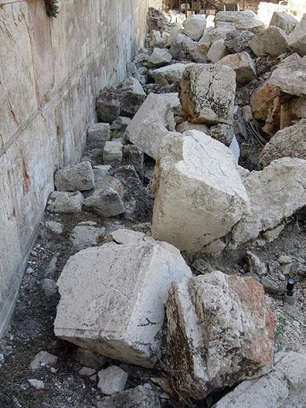
Some of the remaining rubble from when the Romans dumped the temple blocks off of the temple mount.
Mark 13:1-2
As He was going out of the temple, one of His disciples said to Him, "Teacher, behold what wonderful stones and what wonderful buildings!" 2 And Jesus said to him, "Do you see these great buildings? Not one stone will be left upon another which will not be torn down."

