Slide 1

Gal 2:19-20 – My Death with Christ and
Christ’s Life in Me

Slide 2
Review
Definition: a law system is anything you do by your own will and effort that you think will please God
In Gal 2:19 we learned about our freedom (death) from any law system as a way of life
I can’t live to God by putting myself under a law system because God only operates by a grace system and the believer’s faith
Now Gal 2:20 will tell us about my death with Christ and the wonderful results of this death!

Slide 3
Review
Gal 2:20 is a critical and crucial passage
in terms of understanding our position
and identification with Christ. It also
addresses our walk and growth in Christ.
Hal Molloy
Definition: a law system is anything you do in your own will and effort that you think will please God
In Gal 2:19 we learned about our freedom (death) from any law system as a way of life
I can’t live to God by putting myself under a law system because God only operates by a grace system and the believers faith
Now Gal 2:20 will tell us about my death with Christ and the wonderful results of this death!

Slide 4
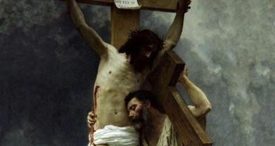
20a I am crucified with Christ: nevertheless I live; yet not I, but Christ lives in me:
I am crucified with Christ
nevertheless I live
yet not I but Christ lives in me
The “I” and “me” are speaking about Paul and every believer in the Lord Jesus Christ. But are all “I’s” the same and if not, who are they referring to?

Slide 5
I am crucified with Christ
Questions:
1. Who was put to death on the cross?
2. How was I crucified with Christ?
3. Why was I crucified with Christ?
4. How do I appropriate being crucified with Christ?

Slide 6
I am crucified with Christ
am crucified – systauroō - to crucify with, crucify
is to put to death on a cross
perfect tense: we were co-crucified in the past and continue to be co-crucified into the present
passive voice: you were acted upon by God
indicative mood: reality (it’s a fact)
Lit: I have been crucified and I stand crucified

Slide 7
I am crucified with Christ
with Christ – we were associated with Christ in His crucifixion and death (spiritually)
1. Who was put to death on the cross?
I = a person
a person = body, soul and spirit
Therefore the I = all who we were in Adam

Slide 8

I am crucified with Christ
2. How was I crucified?
by baptism into Christ’s death and burial
what kind of baptism - water ?
- spiritual ?
1 Cor 12:13a For by one Spirit we were all baptized into one body,

Slide 9
I am crucified with Christ
verses on baptism
Rom. 6:3 or do you not know that all of us who have been baptized into Christ Jesus have been baptized into His death?
Rom. 6:4a we have been buried with Him through baptism into death

Slide 10
I am crucified with Christ
3. Why was I crucified with Christ ?
to be separated from our sin nature
so that our sin nature would be rendered inoperative
so that we do not have to be slaves to our sin nature

Slide 11
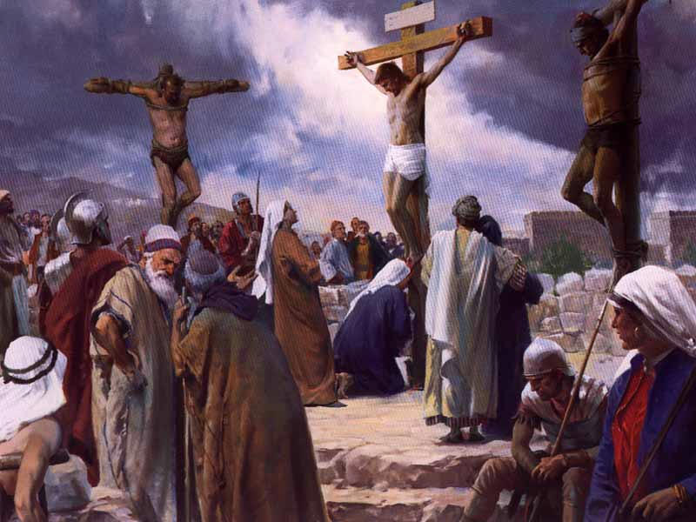
I am crucified with Christ
verses on crucified
Rom. 6:6 knowing this, that our old self was crucified with Him, in order that our body of sin might be done away with (put in idle), so that we would no longer be slaves to sin;
Rom. 6:7 for he who has died is freed from sin

Slide 12
I am crucified with Christ
4. How do I appropriate this in my life?
By reckoning through faith in these facts
Rom. 6:11 Even so consider (reckon) yourselves to be dead to sin, but alive to God in Christ Jesus.

Slide 13

20a I am crucified with Christ: nevertheless I live; yet not I, but Christ lives in me:
nevertheless I live
or from the interlinear “but I am living”
Questions:
1. Who is living (or who is “I”)
2. How was I made alive?
3. What is the purpose of my living?
4. How do I appropriate this?

Slide 14
1. Who is living?
Could this be a different “I” ?
We know the moment you believed you were born again (not physical birth but a spiritual birth)
We also know that you are a new creation in Christ (2 Cor 5:17)
  new = totally new in quality
  you have a new nature (Christ’s nature)
  the old things have passed away (separation)
Therefore the “I” = the new creation in Christ

Slide 15
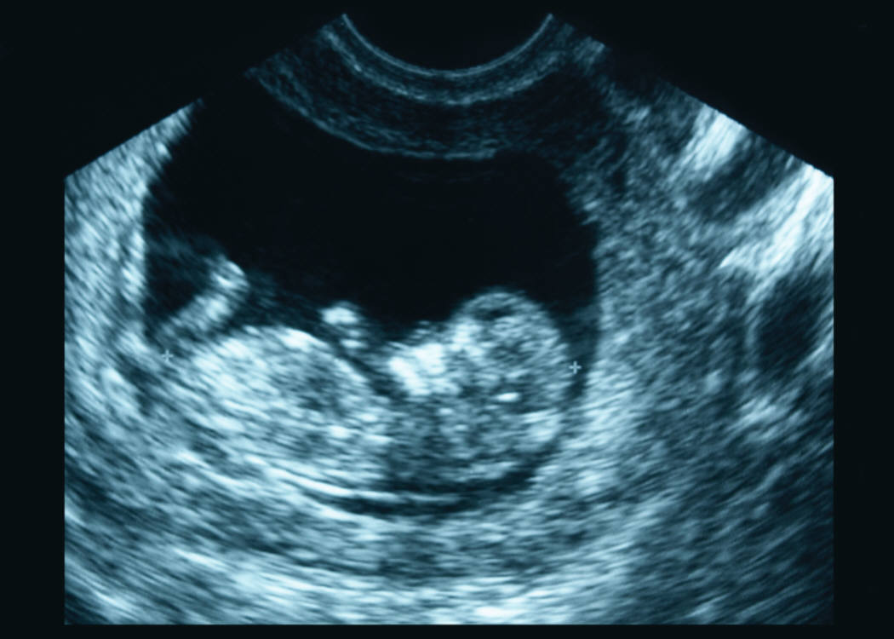
nevertheless I live
(but I am living)
2. How was I made alive?
By baptism into Christ’s resurrection, thus receiving His life and being made totally complete
Col. 2:10 and in Him you have been made complete, and He is the head over all rule and authority

Slide 16
nevertheless I live
(but I am living)
2. How was I made alive? (cont.)
Col. 2:12 having been buried with Him in baptism, in which you were also raised up with Him through faith in the working of God, who raised Him from the dead.

Slide 17
nevertheless I live
lit: but I am living (interlinear)
Could this be a different “I” ?
We know the moment you believed you were born again (not physical birth but a spiritual birth)
We also know that you are a new creation in Christ (2 Cor 5:17)
  new = totally new in quality
  you have a new nature (Christ nature)
  the old things have passed away
Therefore the “I” = the new creation in Christ
3. What is the purpose of my living?
Rom 6:4b --- so that as Christ was raised from the dead through the glory of the Father, so we too might walk in newness of life .
This new in quality nature is Christ’s life!
1 Cor 13:4-8 describes this new life in Christ

Slide 18
Since God is love (1 John 4:9)
Christ and the Father are one
and Christ is our life
1 Cor 13:4-8 would read
⁴ Christ’s life is patient
Christ’s life is kind
Christ’s life is not jealous
Christ’s life does not brag
Christ’s life is not arrogant
⁵ Christ’s life does not act unbecomingly
Christ’s life does not seek its own
Christ’s life is not provoked
Christ’s life does not take into account a wrong suffered
⁶ Christ’s life does not rejoice in unrighteousness
Christ’s life rejoices with the truth
⁷ Christ’s life bears all things
Christ’s life believes all things
Christ’s life hopes all things
Christ’s life endures all things
⁸ Christ’s life never fails

Slide 19
nevertheless I live
(but I am living)
4. How do I appropriate this ?
Rom. 6:6 knowing this, that our old self* was crucified with Him, in order that our body of sin might be done away (put in idle) with, so that we would no longer be slaves to sin;
Rom 6:11 Even so consider (reckon) yourselves to be dead to (the) sin, but alive to God in Christ Jesus.
* all that we were in Adam

Slide 20
Comparison of 2:19 with 2:20a
v19 I am dead to law
– that I might live to God
v 20a I am crucified with Christ
- nevertheless I live
(but I am living)

Slide 21
yet not I, but Christ lives in me:
It is the not I, but Christ’s life!
Rom 8:10 If (since) Christ is in you, though the body is dead because of sin, yet the spirit is alive because of righteousness.
John 14:23b I am in My Father, and you in Me, and I in you.

Slide 22

Final thoughts
Christ is in us in order that His life principle might
liven or animate us. He is not only “the resurrection,”
the escape from death, He is “the life”! Merryman

