Slide 1
Colossians
2-17-2019
Hieropolis
Laodicea
Colossae

Slide 2
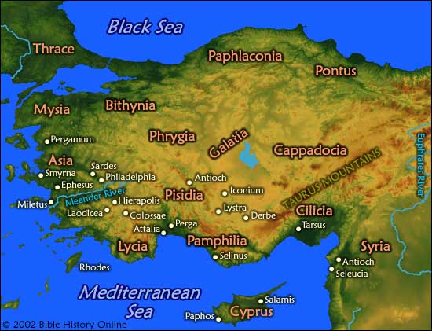
Thyatira

Slide 3
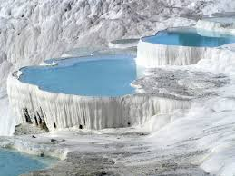
Pemukkale, Turkey

Slide 4
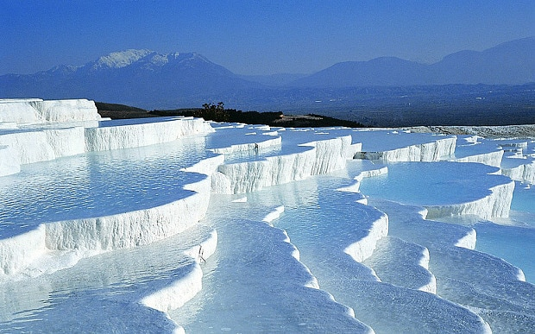
Looking South(?) to Colossae

Slide 5
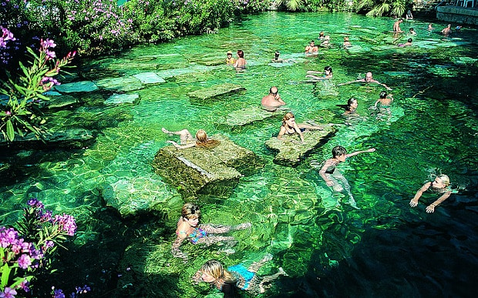
Hieropolus Hot Springs & Ruins

Slide 6
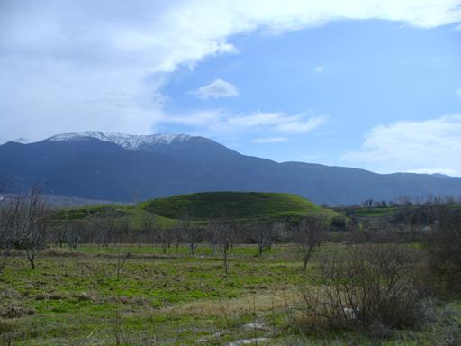
Long Live Colossae!

Slide 7
A Tale of TwoThree Cities
Colossae: had a textile economy: purple-dyed wool, good agriculture in the Lycus River Valley. Famous for its COLD SPRINGS
Hieropolis: a spa town dedicated to it’s HOT spring pools and mineral water. Also had a temple to Apollo/ Pagan center
Laodicea: the financial/banking hub of the tri-city area. Wealthy. Eclipsed the other two cities. Had a medical school; eye and ear salves were made from its minerals. Textile: fine, soft black wool. Water that came there from Hieropolis was LUKEWARM by the time it arrived (by spring or Roman aquaduct) fine

Slide 8
Background of the Writing of the Colossae Epistle
Paul: in Rome, jailed for 4 years
Epaphras: Pastor-teacher to Tri-Cities (McCalley: a circuit rider)
Something was wrong at Colossae: Gnostic apologists were beguiling the little congregation.
Epaphras Went for Help, (60-61? AD) fine

Slide 9
Added Background
Paul heard Epaphras out in Rome, penned 3 letters:
Ephesians
Colossians
?
Philemon fine

Slide 10
Paul’s 3rd Missionary Journey brings him in the Vacinity of the Tri-Cities

Slide 11
The Onesimus Saga
Onesimus: escaped slave from Colossae, made his way to Rome and served Paul there.
Paul had to send him back (legally), (morally) to:
Philemon
House church at Colossae was very, very likely:
Philemon’s fine

Slide 12
Col. 1:6a
v. 5 …. [LAST WEEK:] because of the hope laid up for you in heaven, of which you previously heard in the word of truth, the gospel
THE WAY THE GOSPEL IS HEARD
A. v. 6 (a): ….. which has come to you just as in all the world
Someone always must bring the gospel. It travels. in this case it came from Paul to Epaphras by way of Ephesus.
Wuest: “it has come alongside you”, it has “snuggled up close to you”
CONTRAST this: to this Gnostic [false]gospel they were hearing, that didn’t travel, that was localized & specialized
  B. Correlating Scripture:
  1. Isa 52:7
  “:How beautiful upon the mountains are the feet of him that bringeth good tidings, that publisheth peace; that bringeth good tidings of good, that publisheth salvation; that saith unto Zion, Thy God reigneth!
  2. Rom 10:15
  And how shall they preach unless they are sent? As it is written:
  “How beautiful are the feet of those who preach the gospel of peace,
  Who bring glad tidings of good things!” fine

Slide 13

Col. 1:6b
THE TRUE GOSPEL BEARS FRUIT
A. v. 6 (b): ….. also constantly bearing fruit and increasing
2 Participles: bearing (fruit) and increasing (fruit)
BOTH PARTICIPLES: in middle voice: so what about that?
Meaning: both bearing & increasing (of the fruit) is done with energy and intensity
Also: middle voice denotes an intense interest in the RESULT of the outcome of the action.
True spiritual fruit bearing: regenerative, just like production of crops
Wuest: the gospel is a reproductive organism
As in: MAT. 13:8: parable of the sower: … “And others fell on the good soil and *yielded a crop, some a hundredfold, some sixty, and some thirty.”
The rapid pace of the spreading of the gospel in the first part of Acts
Paul’s missionary journeys planted the gospel all over the world: fine

Slide 14
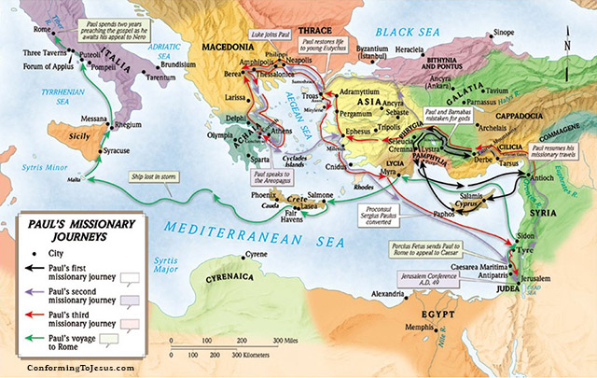

Slide 15
Col. 1:6c
III. GOSPEL’S FRUIT BEARING IS UNIFORM/UNIVERSAL:
A. v. 6 (c): ….. “even as it has been doing in you also since the day you heard of it”
Gr.: Kathos: just as / in the same proportions as / to the degree of ….. Used 2 times in v. 6
B. Skipping to v. 7: ‘just as you learned it from Epaphras
Kathos: again
Simply put: the gospel was carried to the world (cosmos) and bore fruit, and just like it did in the world, it is bearing fruit in you, too, and has the same productive energy with you, too
DIFFERENTIATION: could it be that Paul is trying to really hit home the point in the Colossians minds that they are receiving the SAME exact gospel that the larger, more established believers at Ephesus, Philipi, Thessonalica were receiving to really contrast it to the Gnostic “gospel” that was circulating in the region? fine

Slide 16
Col 1:6d
IV. THE GOSPEL MUST BE UNDERSTOOD
A. v. 6d… “and understood the grace of God in truth;”
When the gospel comes, it needs to be learned and understood to be believed & to have a producing faith.
UNDERSTOOD: epignosko ( vb form of epignosis); to become thoroughly acquainted with; to know accurately.
Merryman: Epignosis relates to only toTRUTH and not falsehoods (like Gnosticism). It’s a personalized knowledge of the truth, knowledge that is “wow” knowledge; not a “so what” knowledge
Wuest puts it this way:
and came to know experientially the grace of God in the sphere of truth fine

Slide 17
Col 1:7-8
V. EPAPHRAS: wrapping up
My new favorite person
Bond-Slave with Paul: a fellow doulos (a willing slave, who loves his master) Luke 7: Roman Centurion’s slave; also: loved by his master
A servant (deokonos) of Christ:
Paul: a high, high level of confidence in this minister to the Tri-City area
VI. NOTE ON THE SPIRIT
This is the only mention of the Spirit in Colossians
Contrast: He is mentioned 11 times in Ephesians
The H.S. is chosing in this letter to remain invisible / way in the background. Why?
To put the full strength & emphasis on the Person of Christ and His Headship over the body fine

Slide 18
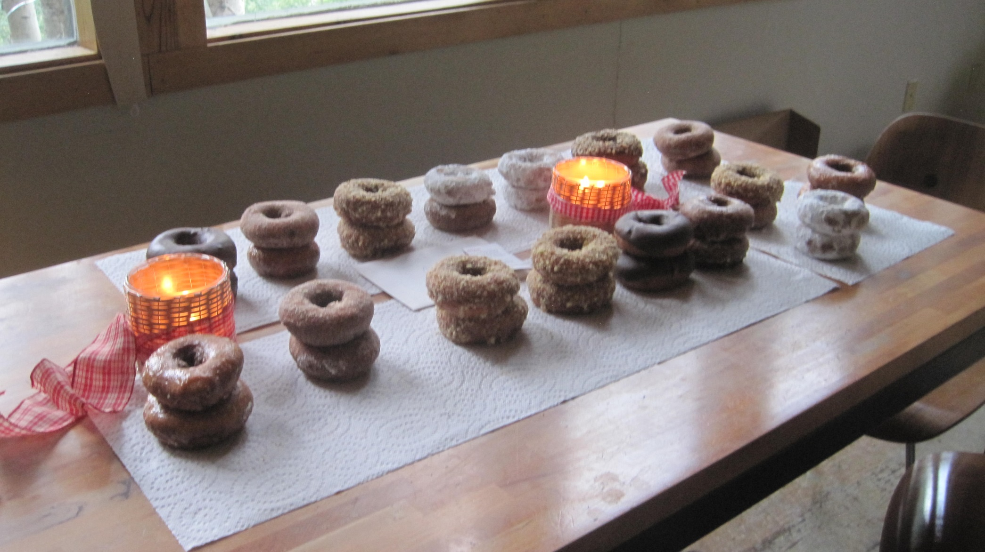
Here is Heaven:
(response to Bob from last week’s lesson)

