Slide 1
Micah Class Schedule

Slide 2
Micah - Chapter 2:1-11
The Sins of Judah - Part 1
Holly Hills Bible Church – Nov 17, 2024

Slide 3
Micah 2:1-6
¹ Woe to those who scheme iniquity, Who work out evil on their beds! When morning comes, they do it, For it is in the power of their hands.
² They covet fields and then seize them, And houses, and take them away. They rob a man and his house, A man and his inheritance.
³ Therefore thus says the LORD, "Behold, I am planning against this family a calamity From which you cannot remove your necks; And you will not walk haughtily, For it will be an evil time.
⁴ "On that day they will take up against you a taunt And utter a bitter lamentation and say, 'We are completely destroyed! He exchanges the portion of my people; How He removes it from me! To the apostate He apportions our fields.'
⁵ "Therefore you will have no one stretching a measuring line For you by lot in the assembly of the LORD.
⁶ 'Do not speak out,' so they speak out. But if they do not speak out concerning these things, Reproaches will not be turned back.

Slide 4
Micah 2:7-11
⁷ "Is it being said, O house of Jacob: 'Is the Spirit of the LORD impatient? Are these His doings?' Do not My words do good To the one walking uprightly?
⁸ "Recently My people have arisen as an enemy— You strip the robe off the garment From unsuspecting passers-by, From those returned from war.
⁹ "The women of My people you evict, Each one from her pleasant house. From her children you take My splendor forever.
¹⁰ "Arise and go, For this is no place of rest Because of the uncleanness that brings on destruction, A painful destruction.
¹¹ "If a man walking after wind and falsehood Had told lies and said, 'I will speak out to you concerning wine and liquor,' He would be spokesman to this people.

Slide 5
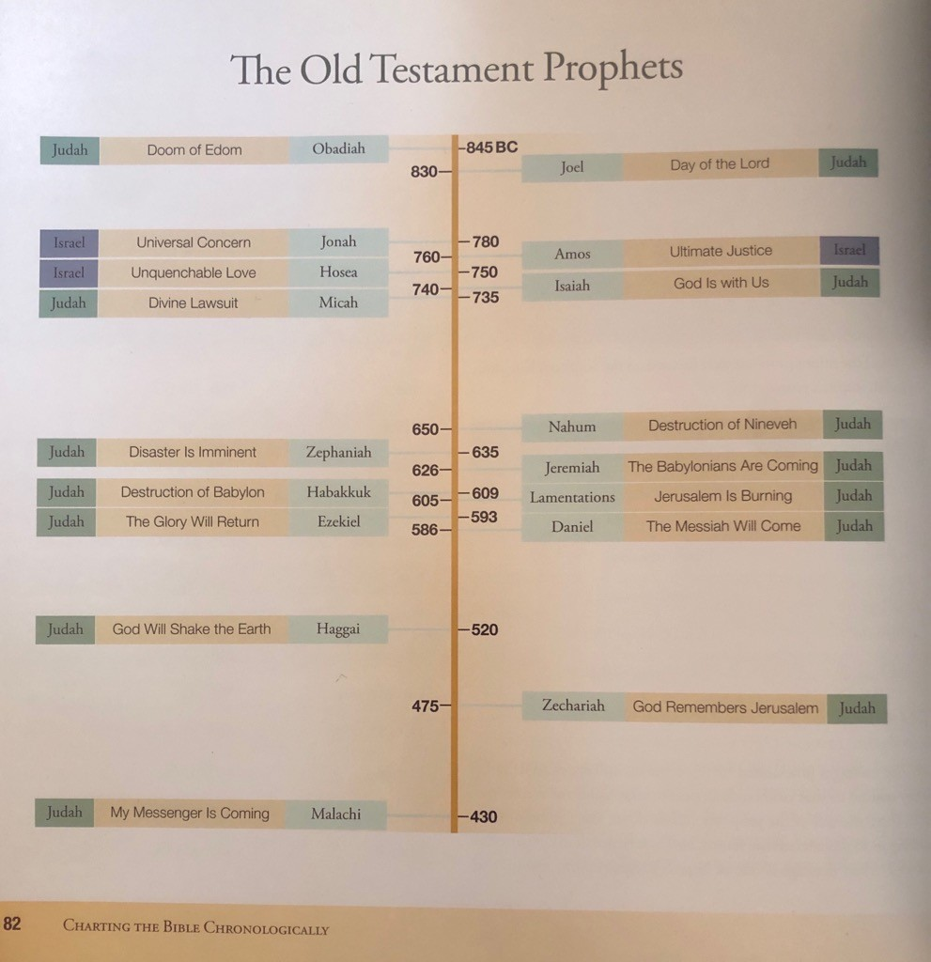
Charting the Bible Chronologically,
Ed Hindson & Thomas Ice
2016 Harvest House Publishers

Slide 6
722 Exile of Israel
Charting the Bible Chronologically,
Ed Hindson & Thomas Ice
2016 Harvest House Publishers

Slide 7
722 Exile of Israel
586 Exile of Judah
Charting the Bible Chronologically,
Ed Hindson & Thomas Ice
2016 Harvest House Publishers

Slide 8
722 Exile of Israel
586 Exile of Judah
Charting the Bible Chronologically,
Ed Hindson & Thomas Ice
2016 Harvest House Publishers

Slide 9
The Northern and Southern Kingdoms
Israel is the name that God gave to Jacob. (Gen 32:28)
The Israelites went down to Egypt as a family. But the Lord called Israel out of Egypt as a nation. (Deut. 4:34)
“Jacob” and “Israel” = The patriarch Jacob OR The entire Nation
BUT… under Solomon's son Rehoboam, the Kingdom of Israel was split into Northern and Southern kingdoms.
The Northern Kingdom retained the name “Israel.”
“Jacob” and “Israel” = The patriarch Jacob, The entire Nation OR the Northern Kingdom.
How do we know which one? (Context, context, context!)
During this time “Israel” usually refers to the Northern Kingdom, BUT…

Slide 10
The Northern and Southern Kingdoms
What about the Southern Kingdom?
It was called Judah.
Israel = the Northern Kingdom
Judah = the Southern Kingdom
BUT there’s more…
Ephraim & Samaria = the Northern Kingdom
Jerusalem (Zion) = the Southern Kingdom

Slide 11
The Northern and Southern Kingdoms
Northern Kingdom = Israel, Jacob, Ephraim, Samaria
Southern Kingdom = Judah, Jerusalem (Zion)
Name | Primary Meaning | Other Uses
Israel or Jacob | The patriarch Jacob | The whole nation of Israel The Northern Kingdom
Judah | The individual son of Jacob | The tribe of Judah The Southern Kingdom
Ephraim | The individual son of Joseph | The tribe of Ephraim The Northern Kingdom
Samaria | Capital of the Northern Kingdom | To represent the entire Northern Kingdom
Jerusalem | Capital of the Southern Kingdom | To represent the entire Southern Kingdom
Zion | The Temple Mount | To represent Jerusalem

Slide 12
Who is Micah’s Audience?
Micah is predicting the shameful treatment of King Zedekiah at the time of the Babylonian invasion of the Southern Kingdom of Judah. - Charles Feinberg
Micah uses the term “Israel” to refer to the Southern Kingdom.

Slide 13
Why would Micah do this?
At this point God is done with the Northern Kingdom. Their destruction and exile is guaranteed.
The language signifies that the only thing left of Israel is the Southern Kingdom.
"In those days the house of Judah will walk with the house of Israel, and they will come together from the land of the north to the land that I gave your fathers as an inheritance.”
Jer 3:18

Slide 14
God’s Covenant Program with Israel
Leviticus 26 and Deuteronomy 28
Blessings for obedience, but cursings for disobedience.
Stage 1 = 15-17
Stage 2 = 18-20
Stage 3 = 21-22
Stage 4 = 23-26
Stage 5 = 27-39 EXILE!
After exile, comes final restoration!!

Slide 15
Understanding Micah
The prophets primarily remind Israel of what was already foretold in God’s covenants with Israel.
God’s covenants with Israel are legal in nature.
Micah is acting like a prosecuting attorney on God's behalf.
His job is to show Judah exactly how they have violated God's law.

