Slide 1
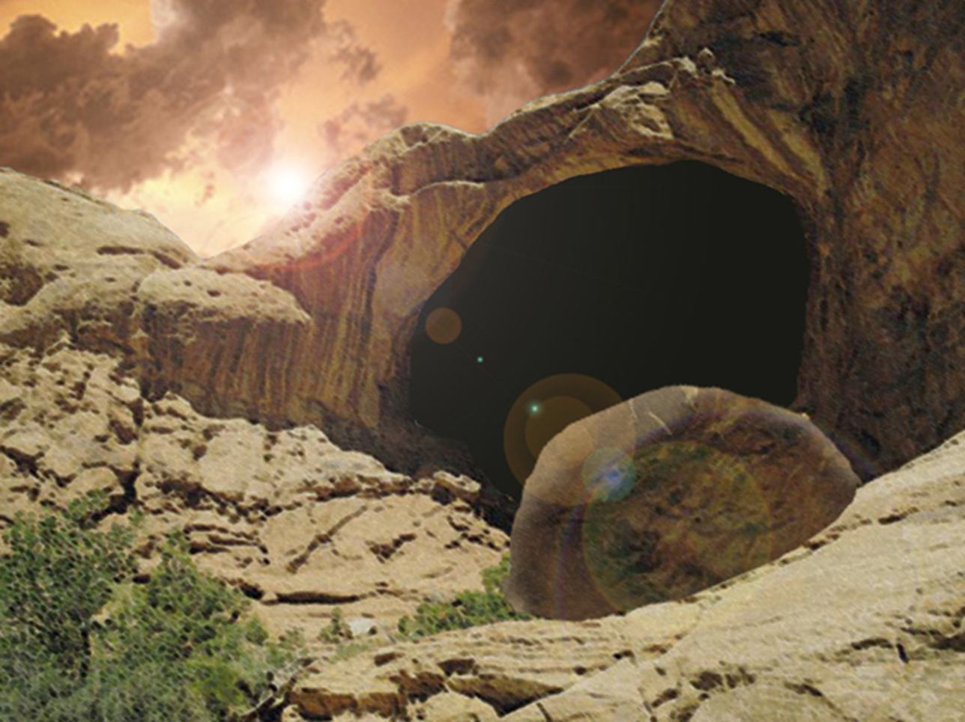
He is Risen! He is Risen, Indeed!

Slide 2
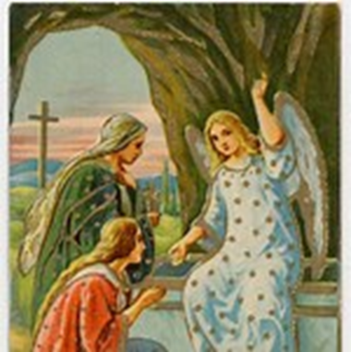
Mark 16:6 And he said to them, "Do not be amazed; you are looking for Jesus the Nazarene, who has been crucified. He has risen; He is not here; behold, here is the place where they laid Him.
Introduction to the Resurrection of Christ
Proofs of the Resurrection of Christ
Significance of Christ’s Resurrection for Believers

Slide 3
Introduction to the Resurrection of Christ
The cornerstone of the Christian faith is the resurrection of Jesus Christ; without it there would be no reason to believe that Jesus could save us from anything. McGee
1 Corinthians 15:12 Now if Christ is preached, that He has been raised from the dead, how do some among you say that there is no resurrection of the dead? 13 But if there is no resurrection of the dead, not even Christ has been raised; 14 and if Christ has not been raised, then our preaching is vain, your faith also is vain.
Resurrection – a rising of the physical body from the dead with a body that will never die physically again. This resurrection has come to pass only in the case of Jesus Christ alone & will come to pass in all men according to God’s order at the end of this age. H. Molloy

Slide 4
What would be the most convincing proof
of Christ’s resurrection?
to see Him face to face
to talk to Him and hear his voice
to touch Him - shake His hand, hug Him, ---

Slide 5
17 Appearances after the Resurrection*
Appeared to Place Verses
Mary Magdalene outside the tomb John 20:11-17
The women running from the tomb Matt. 28:9-10
Peter somewhere in Jerusalem Luke 24:34
The disciples road to Emmaus Luke 24:13-35
The 10 disciples Jerusalem? John 20:19-24
The 11 disciples Jerusalem? John 20:26-29
The 7 disciples sea of Galilee John 21:1-23
The five hundred not stated 1 Cor. 15:6
James - Lord's brother not stated 1 Cor. 15:7
* Chafer

Slide 6
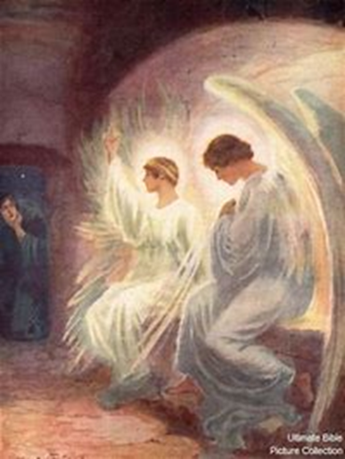
Mary Magdalene - outside the tomb –part 1
¹¹ But Mary was standing outside the tomb weeping; and so, as she wept, she stooped and looked into the tomb;
¹² and she saw two angels in white sitting, one at the head and one at the feet, where the body of Jesus had been lying.
¹³ And they said to her, "Woman, why are you weeping?" She said to them, "Because they have taken away my Lord, and I do not know where they have laid Him."
¹⁴ When she had said this, she turned around and saw Jesus standing there, and did not know that it was Jesus.

Slide 7
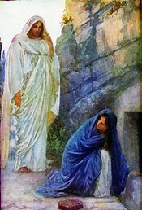
Mary Magdalene - outside the tomb – part 2
¹⁵ Jesus said to her, "Woman, why are you weeping? Whom are you seeking?" Supposing Him to be the gardener, she said to Him, "Sir, if you have carried Him away, tell me where you have laid Him, and I will take Him away.“
¹⁶ Jesus said to her, "Mary!" She turned and said to Him in Hebrew, "Rabboni!" (which means, Teacher).
¹⁷ Jesus *said to her, "Stop clinging to Me, for I have not yet ascended to the Father; but go to My brethren and say to them, 'I ascend to My Father and your Father, and My God and your God.'"

Slide 8
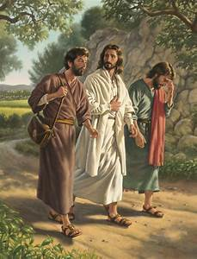
4. Road to Emmaus - part 1
¹³ And behold, two of them were going that very day to a village named Emmaus, which was about seven miles from Jerusalem.
¹⁵ While they were talking and discussing, Jesus Himself approached and began traveling with them.
¹⁶ But their eyes were prevented from recognizing Him.
¹⁸ ----"Are You the only one visiting Jerusalem and unaware of the things which have happened here in these days?"
¹⁹ --- "The things about Jesus the Nazarene, who was a prophet mighty in deed and word in the sight of God and all the people, ²⁰ and how the chief priests and our rulers delivered Him to the sentence of death, and crucified Him.

Slide 9
4. Road to Emmaus – part 2
---²² "But also some women among us amazed us. When they were at the tomb early in the morning,
²³ and did not find His body, they came, saying that they had also seen a vision of angels who said that He was alive. ²⁴ "Some of those who were with us went to the tomb and found it just exactly as the women also had said; but Him they did not see.“
²⁹ But they urged Him, saying, "Stay with us, for it is getting toward evening, and the day is now nearly over." So He went in to stay with them.
³⁰ When He had reclined at the table with them, He took the bread and blessed it, and breaking it, He began giving it to them. ³¹ Then their eyes were opened and they recognized Him; and He vanished from their sight.

Slide 10
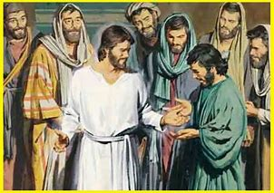
5. 10 Disciples without Thomas
¹⁹ So when it was evening on that day, the first day of the week, and when the doors were shut where the disciples were, for fear of the Jews, Jesus came and stood in their midst and *said to them, "Peace be with you."
²⁰ And when He had said this, He showed them both His hands and His side. The disciples then rejoiced when they saw the Lord.
²¹ So Jesus said to them again, "Peace be with you; as the Father has sent Me, I also send you." ----²⁴ But Thomas, one of the twelve, called Didymus, was not with them when Jesus came.

Slide 11
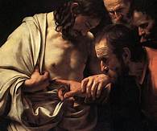
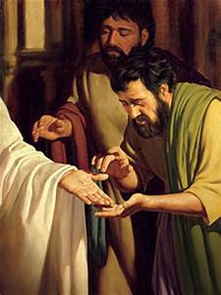
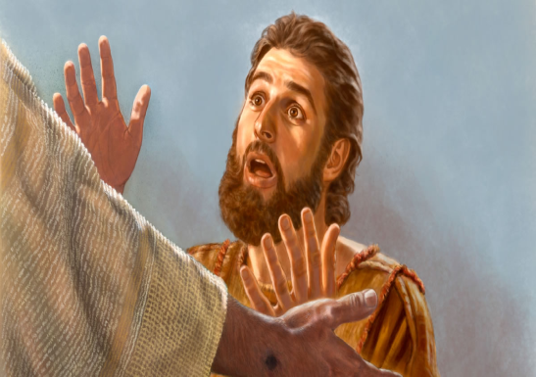
6. 11 Disciples – with Thomas
²⁶ After eight days His disciples were again inside, and Thomas with them. Jesus *came, the doors having been shut, and stood in their midst and said, "Peace be with you."
²⁷ Then He *said to Thomas, "Reach here with your finger, and see My hands; and reach here your hand and put it into My side; and do not be unbelieving, but believing."
²⁸ Thomas answered and said to Him, "My Lord and my God!" ²⁹ Jesus *said to him, "Because you have seen Me, have you believed? Blessed are they who did not see, and yet believed."

Slide 12
17 Appearances after the Resurrection (cont.)
Appeared to Place Verses
the disciples a mountain in Galilee Matt. 28:16-20
the disciples mount of Olives* Acts 1:3-9
Stephen prior to being martyred Acts 7:55-56
Paul road to Damascus Acts 9:3-6
Paul in Arabia Gal 1:12&17
Paul in the temple Acts 22:17-21
Paul in prison in Caesarea Acts 23:11
the apostle John island of Patmos Rev 1:12-20
* Christ’s ascension

Slide 13
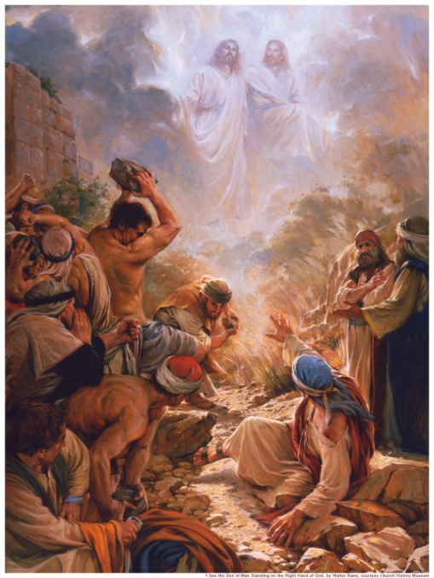
12. Stephen martyred
⁵⁵ But being full of the Holy Spirit, he gazed intently into heaven and saw the glory of God, and Jesus standing at the right hand of God;
⁵⁶ and he said, "Behold, I see the heavens opened up and the Son of Man standing at the right hand of God.“
⁵⁷ But they cried out with a loud voice, and covered their ears and rushed at him with one impulse. ⁵⁸ When they had driven him out of the city, they began stoning him; and the witnesses laid aside their robes at the feet of a young man named Saul.
⁵⁹ They went on stoning Stephen as he called on the Lord and said, "Lord Jesus, receive my spirit!"

Slide 14
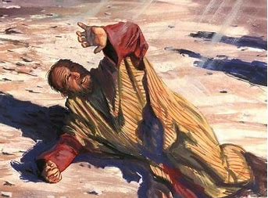
13. Paul on the Damascus road
³ As he was traveling, it happened that he was approaching Damascus, and suddenly a light from heaven flashed around him;
⁴ and he fell to the ground and heard a voice saying to him, "Saul, Saul, why are you persecuting Me?“
⁵ And he said, "Who are You, Lord?" And He said, "I am Jesus whom you are persecuting,
⁶ but get up and enter the city, and it will be told you what you must do.“

Slide 15
Mark 16:6 And he said to them, "Do not be amazed; you are looking for Jesus the Nazarene, who has been crucified. He has risen; He is not here; behold, here is the place where they laid Him.
Introduction to the Resurrection of Christ
Proofs of the Resurrection of Christ
Significance of Christ’s Resurrection for Believers

Slide 16
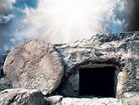
Significance of Christ’s Resurrection for believers*
(Part 1)
The resurrection is the basis for the believer’s faith & hope
2. The resurrection is the basis for imputed righteousness & the believer’s justification
3. The resurrection is the basis for the believer’s life
4. The resurrection is the means of our intercession
with God
5. The resurrection power can be
appropriated to a believer’s life
* H. Molloy

Slide 17
The resurrection is the basis for the believer’s faith & hope
our faith and hope can be in God because of the Father raising the Son in great glory 1 Peter 1:20
who according to His great mercy has caused us to be born again to a living hope through the resurrection of Jesus Christ from the dead, 1 Peter 1:3
to obtain an inheritance which is
imperishable and
undefiled and
will not fade away,
reserved in heaven for you, 1 Peter 1:4

Slide 18
3. The resurrection is the basis for the
believer’s life
We can now walk in newness of life (new in quality life – Christ’s life) since Christ was raised from the dead through the glory of the Father – Rom 6:4
Because I was crucified and raised (resurrected) with Christ, I now live. It is not the old Adamic I, but Christ is living in me Gal 2:20
I am not only to know (by experience) Him but also know the power of His resurrection Phil 3:10a

Slide 19
Significance of Christ’s Resurrection for Believers
(Part 2)
6. Provides hope (absolute assurance) for tomorrow
7. The basis for the believer’s identification, union & life in Christ
8. It guarantees the believer’s resurrection
9. It is our guarantee that we have eternal
life

Slide 20
6. Provides hope (absolute assurance) for tomorrow
read 1 Cor 15:12-19
But Christ is risen!
- Our proclaiming it is not in vain
- Our faith is profitable
- We are true witnesses of God
- We are no longer in our sins
- The dead in Christ will live
- We have hope for eternity
- We live with joy in the Lord!

Slide 21
8. It’s the guarantee of the believer’s resurrection
He (God the Father) who raised Christ Jesus from the dead will also give life to your mortal bodies through His Spirit who dwells in you. or “make alive your mortal bodies”
1 Cor 6:14 Now God has not only raised the Lord,
but will also raise us up through His power.
1 Thess 4:14 For if we believe that Jesus died and rose again,
even so God will bring with Him those who have fallen asleep in Jesus.

Slide 22
9. It’s our guarantee that we have eternal life
John 11:25-26
- ²⁵Jesus said to her, "I am the resurrection and the life;
- he who believes in Me will live even if he dies,
- ^{26a} and everyone who lives and believes in Me will never die.
John 17:2-3
² even as You gave Him authority over all flesh, that to all
whom You have given Him, He may give eternal life.
³ "This is eternal life, that they may know You, the only true
God, and Jesus Christ whom You have sent.

